Slide 1


JavaScript violence
or “How to do OOP with JavaScript the nice way”

Slide 2




About me
Yulia Tenincheva
NodeJS Developer
GitHub : Y-LyN-10
Twitter : @3thelfleda
Email : yulia.ten@dezigner.ru

Slide 3

So… you know how awesome JS is, right?

Slide 4
Prototypes vs. classes
var Employee = (function() {
function Employee(){}
Employee.prototype.doWork = function() {
return 'complete!';
}
return Employee;
}());
class Employee {
doWork(){
return 'complete!';
}
}
var pesho = new Employee();
pesho.doWork(); // complete!

Slide 5

Constructor, Getters & Setters

Slide 6
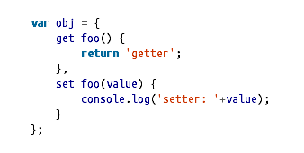
Constructor, Getters & Setters
class Employee {
constructor(name){
this._name = name;
}
get name(){
return this._name;
}
set name(name){
// Validations…
this._name = name;
}
}
The syntax for getters and setters is just like in
ECMAScript Object literals

Slide 7
Inheritance
class Person {
constructor(name){
this._name = name;
}
get name(){
return this._name;
}
set name(name){ this._name = name;
}
}
class Employee extends Person {
// Employee “is-a” person
doWork(){
return `${this._name} is working`;
}
}
var pesho = new Employee(‘Pesho’);
pesho.doWork(); // Pesho is working

Slide 8
Super!
super() calls the parent function depending on the context and then returns the result.
Most use cases will just use the super() method inside of a class constructor.
class Employee extends Person {
constructor(name, title){
super(name);
this._title = title;
}
}
Calling super.toString() from within a child class will call the base class you inherited.
Employee.prototype.toString.call(this);
super.toString();

Slide 9

DEMO
Vehicle Park Task Solution in ES6
ES6 is here!

Slide 10

… full of new awesome features

Slide 11
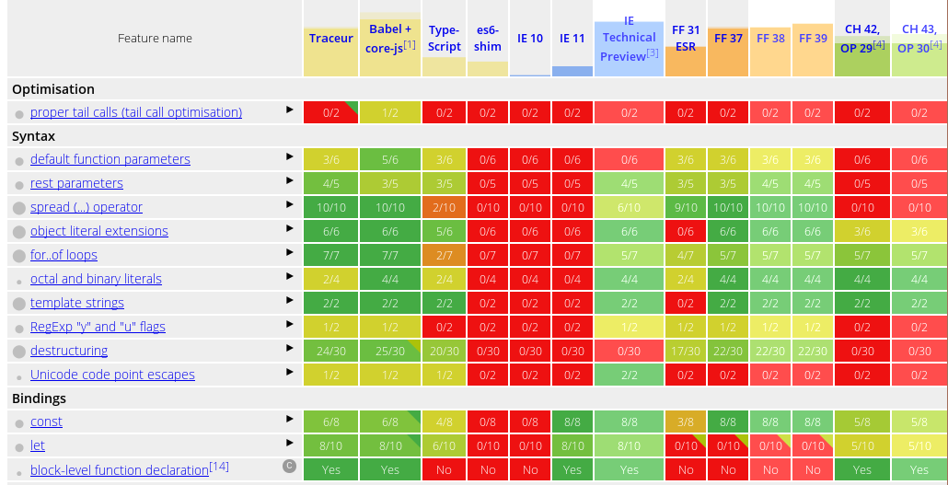

but… how, where?

Slide 12
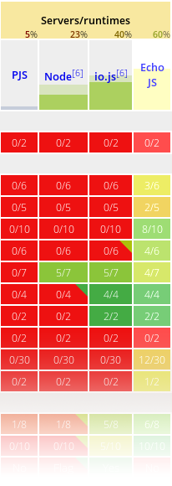


but… how, where?

Slide 13



so… How to use ES6 today?

Slide 14




